Slide 1
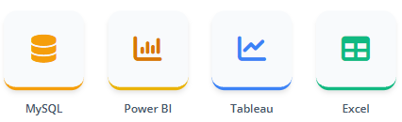
Olist Store Analysis
Project Overview
This project analyzes sales, profit, cost, customer, product, performance of Adventure Works Cycles. The objective is to derive business insights using SQL queries and visualize them through Power BI, Tableau, and Excel dashboards.
Sales & Profit Performance Analysis
GROUP NO.: -2
Sahil Banger
Mohammad Ashwak Ahmad
Shivrudra Madhav Salunke
Kumud Kundan Patil
Amanveer Pratap
Jaffer Mydeen A
Talari Sheshu
Tools & Technologies

Slide 2
Agenda
Presentation Outline
7. KPI 5 – Impact of Delivery Time on Customer Review Scores
1. Project Overview
8. Power BI Dashboard Overview
2. Agenda
9. SQL Queries Used
3. KPI 1 – Order Distribution by Day Type
10. Tableau Dashboard Overview
4. KPI 2 – 5-Star Orders by Payments Type
11. Excel Dashboard Overview
5. KPI 3 – Average Delivery Time for Pet shop Product
12. Business Conclusions & Recommendations
6. KPI 4 – Average Order Price vs Payment value for Sao Paulo
13. Challenges Faced & How We Overcame Them

Slide 3
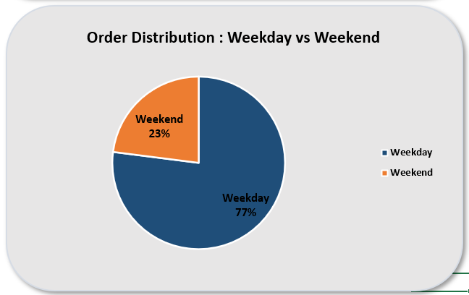
KPI 1 – Order Distribution by Day Type
Key Observations
A significantly higher number of orders are placed on weekdays compared to weekends.
Weekend orders represent a smaller share of total purchases.
Customer purchasing activity is concentrated during regular working days
Business Insight
Businesses can increase weekend sales by introducing weekend promotions, discounts, or limited-time offers to encourage more purchases during low-activity periods.

Slide 4
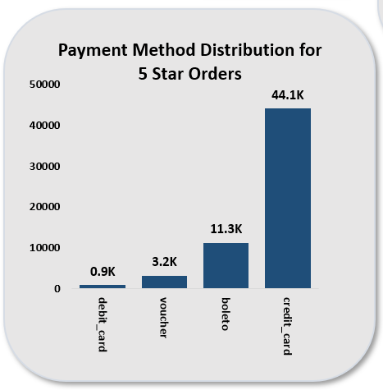
KPI 2 – 5-Star Orders by Payments Type
Key Observations
Credit card payments dominate the number of 5-star rated orders.
Other payment methods such as boleto, voucher, and debit card have significantly lower order counts.
Digital payment users appear to provide higher customer satisfaction ratings
Business Insight
Encouraging digital payment methods like credit cards through cashback or rewards can improve checkout convenience and potentially increase positive customer reviews

Slide 5
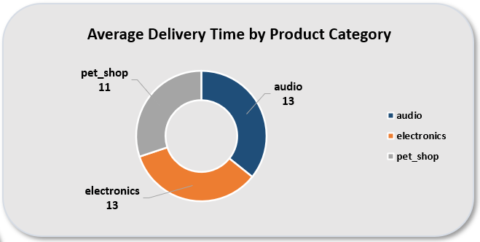
KPI 3 – Average Delivery Time for Pet shop Product
Key Observations
The pet_shop category has an average delivery time of around 11–12 days.
Delivery performance is relatively consistent compared to other categories.
Shipping time is a critical factor influencing customer experience.
Business Insight
Improving logistics efficiency and reducing delivery times can enhance customer satisfaction and increase repeat purchases in the pet product category.

Slide 6
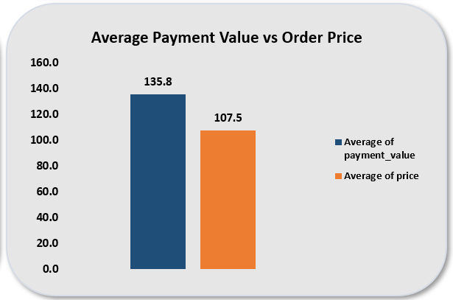
KPI 4 – Average Order Price vs Payment value for Sao Paulo
Key Observations
Customers located in São Paulo show relatively high average payment values.
The average payment value is higher than the average product price, indicating possible additional costs like shipping or multiple items per order.
São Paulo represents a high-value customer segment.
Business Insight
Businesses should prioritize regional marketing strategies and targeted campaigns in São Paulo to maximize revenue from this high-spending market.

Slide 7
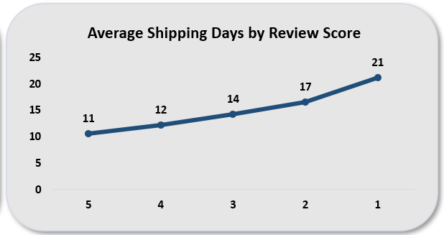
KPI 5 – Impact of Delivery Time on Customer Review Scores
Key Observations
Orders with higher review scores tend to have shorter delivery times
Lower review scores are associated with longer shipping durations.
Customer satisfaction is strongly linked to delivery speed and service efficiency.
Business Insight
Optimizing delivery logistics and reducing shipping delays can significantly improve customer satisfaction ratings and overall brand reputation.

Slide 8
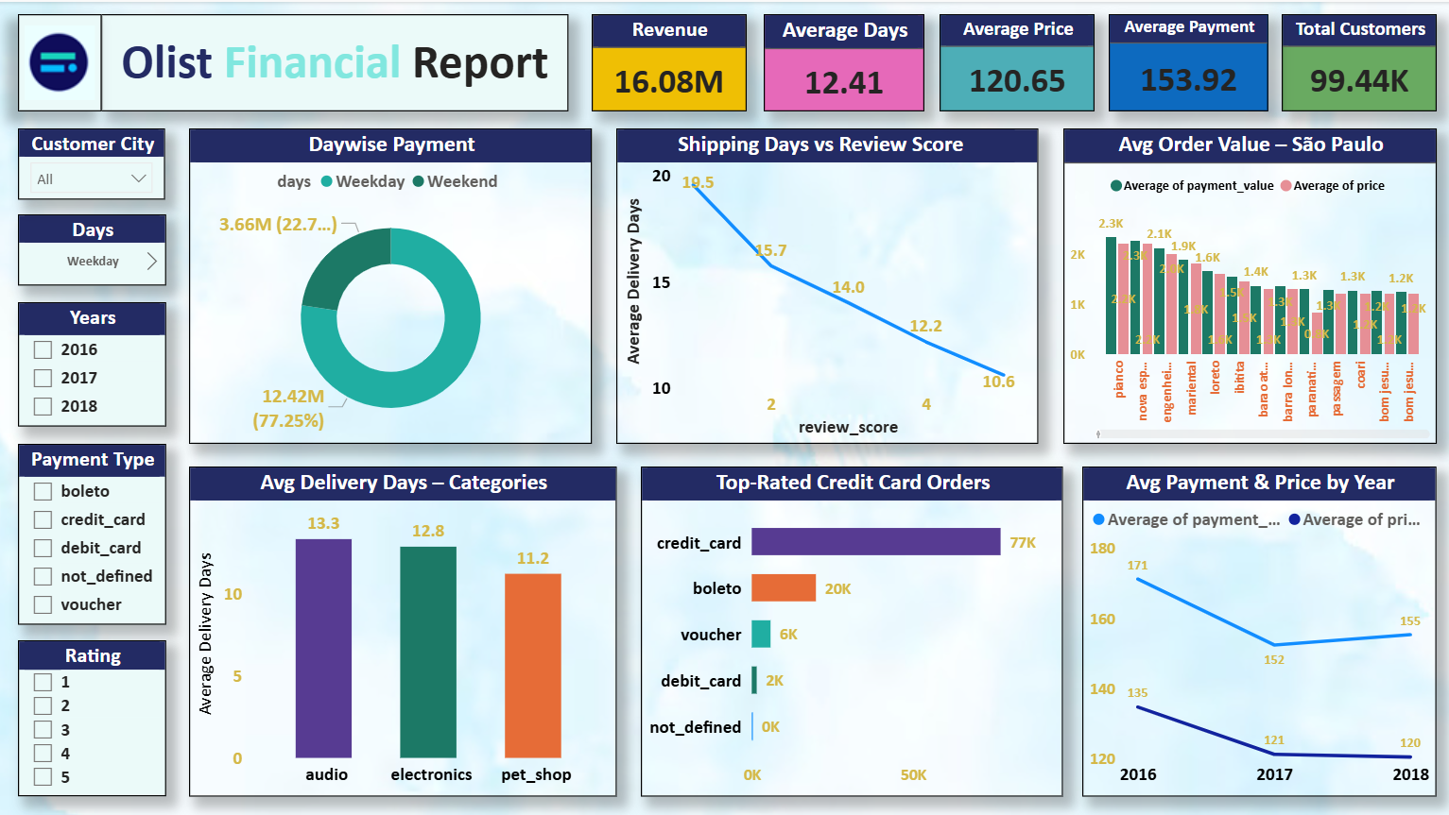
Power BI Dashboard

Slide 9
SQL Queries Used
#KPI1
create table kpi1 as SELECT
CONCAT(ROUND(COUNT(CASE WHEN WEEKDAY(order_purchase_timestamp) < 5 THEN 1 END)*100 / COUNT(*),0),
'%') AS weekday_percent,
CONCAT(ROUND(COUNT(CASE WHEN WEEKDAY(order_purchase_timestamp) >= 5 THEN 1 END)*100 / COUNT(*),0),
'%') AS weekend_percent FROM orders;
select * from kpi1;
#KPI2
create table kpi2 as SELECT
p.payment_type,CONCAT(ROUND(COUNT(*)/1000,1),'K') AS no_of_orders FROM order_reviews r
JOIN order_payments p ON r.order_id = p.order_id WHERE r.review_score = 5
GROUP BY p.payment_type ORDER BY COUNT(*) DESC;
select * from kpi2;

Slide 10
SQL Queries Used
#KPI3
create table kpi3 as SELECT
pt.product_category_name_english AS category,ROUND(AVG(o.shipping_days),0) AS average_shipping_days
FROM products p JOIN product_category_translation pt ON p.product_category_name = pt.product_category_name
JOIN order_items oi ON p.product_id = oi.product_id
JOIN orders o ON oi.order_id = o.order_id
WHERE pt.product_category_name_english LIKE '%pet%’
GROUP BY category;
select * from kpi3;
#KPI4
create table kpi4 as SELECT
( SELECT ROUND(AVG(p.payment_value),0)
FROM order_payments p
JOIN orders o ON p.order_id = o.order_id
JOIN customers c ON o.customer_id = c.customer_id
WHERE c.customer_city = 'sao paulo' AND o.order_status = 'delivered') AS avg_payment_value,
( SELECT ROUND(AVG(oi.price),0)
FROM order_items oi
JOIN orders o ON oi.order_id = o.order_id
JOIN customers c ON o.customer_id = c.customer_id
WHERE c.customer_city = 'sao paulo' AND o.order_status = 'delivered') AS avg_price;
Select * from kpi4;

Slide 11
SQL Queries Used
#KPI5
create table kpi5 as SELECT
r.review_score,ROUND(AVG(DATEDIFF(o.order_delivered_customer_date, o.order_purchase_timestamp)),0) AS avg_delivery_days
FROM order_reviews r
JOIN orders o ON r.order_id = o.order_id
WHERE o.order_delivered_customer_date IS NOT NULL
GROUP BY r.review_score
ORDER BY r.review_score DESC;
select * from kpi5;

Slide 12
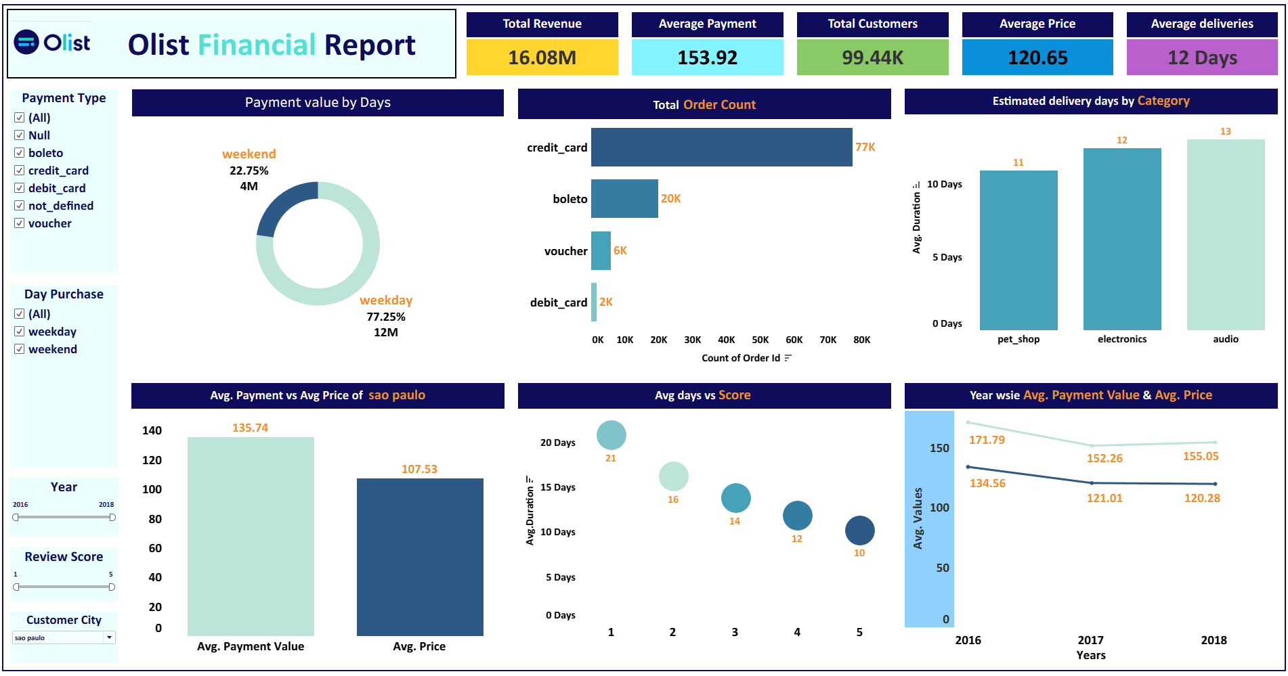
Tableau Dashboard

Slide 13
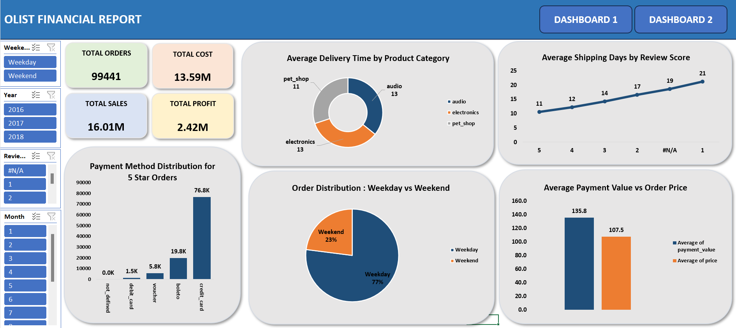
Excel Dashboard

Slide 14
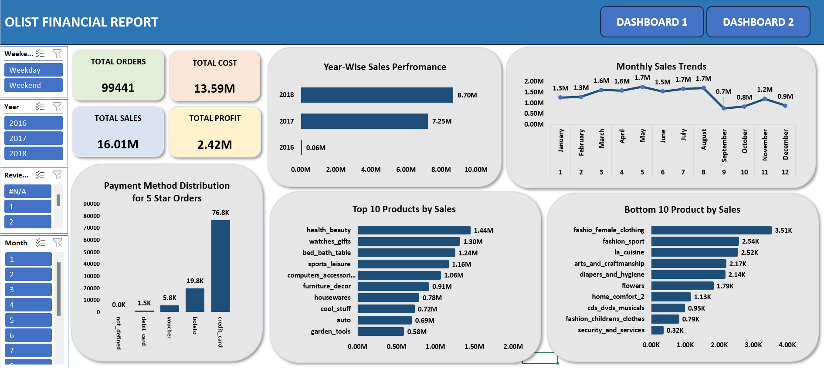
Excel Dashboard

Slide 15
Conclusion & Recommendations
Strategic Business Insights
Key Conclusions
Recommendations
1.Credit Card Dominates Customer Payments
Most orders are completed using credit card, indicating customers prefer fast and secure digital payment methods
Compared to debit card , vouchers, or boleto.
2.Weekday Orders Are Significantly Higher
The majority of purchases occur during weekdays, suggesting customers shop more during regular working days rather than weekends.
3.Faster Delivery Leads to Higher Customer Satisfaction
Orders delivered faster receive higher review scores, showing that delivery speed is a key factor influencing customer satisfaction.
4, São Paulo Customers Show Higher Spending Behavior
Customers from São Paulo have higher average payment values, indicating strong purchasing power and making this region a critical market for revenue generation.
1. Optimize Weekend Promotions
Launch targeted promotions or flash sales during weekends to balance sales distribution and increase order volume on low-traffic days.
2. Improve Delivery Logistics
Focus on reducing shipping times by optimizing logistics partnerships, warehouse placement, and last-mile delivery operations to improve customer satisfaction.
3. Expand High-Demand Product Categories
Increase inventory and marketing efforts for high-performing categories such as electronics, audio products, and pet supplies to maximize revenue opportunities.
4. Target High-Value Markets
Strengthen marketing campaigns in São Paulo and other high-spending cities through personalized promotions and loyalty programs to retain valuable customers.

Slide 16
Challenges Faced & How We Overcame Them
Challenges
Solution
Data Quality and Missing Values
Some fields such as delivery dates and product categories contained missing or inconsistent data.
2.Complex Data Relationships Across Multiple Tables
The dataset was spread across multiple tables such as orders, customers, payments, products, and reviews.
3. Delivery Time Calculation Issues
Date fields initially returned incorrect formats when calculating shipping days.
4. Dashboard Visualization and Layout Design
Choosing the right charts and maintaining a clean layout was challenging.
5. Cross-Tool KPI Consistency
Ensuring the same results across SQL queries, Excel analysis, and BI dashboards required validation.
Cleaned and standardized the dataset using Excel data cleaning techniques and SQL filtering.
Used SQL joins and relationships in Power BI/Tableau to correctly connect the datasets.
Converted date fields and used calculated columns (DATEDIFF / Excel formulas) to accurately compute delivery time.
Applied data aggregation, filtering, and optimized queries in SQL to improve performance.
Standardized calculations and validated KPIs across all tools to maintain accuracy.
implemented consistent visual design principles in Power BI/Tableau, selecting appropriate charts for KPIs.

Slide 17
Thank You

